Slide 1


Azərbaycan Dövlət Neft və Sənaye Universiteti
Calculus
Single Variable

Slide 2
Applications of Integration
Volume: The Disk Method
& The Washer Method

Slide 3
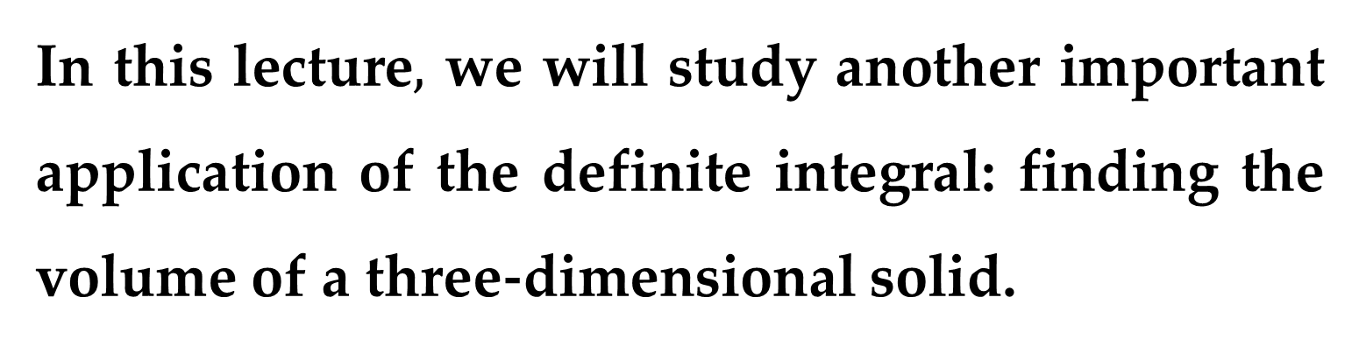
In this lecture$,$ we will study another important application of the definite integral: finding the volume of a three-dimensional solid.
In trying to find the volume of a solid we face the same type of problem as in finding areas.
We have an intuitive idea of what volume means, but we must make this idea precise by using calculus to give an exact definition of volume.

Slide 4
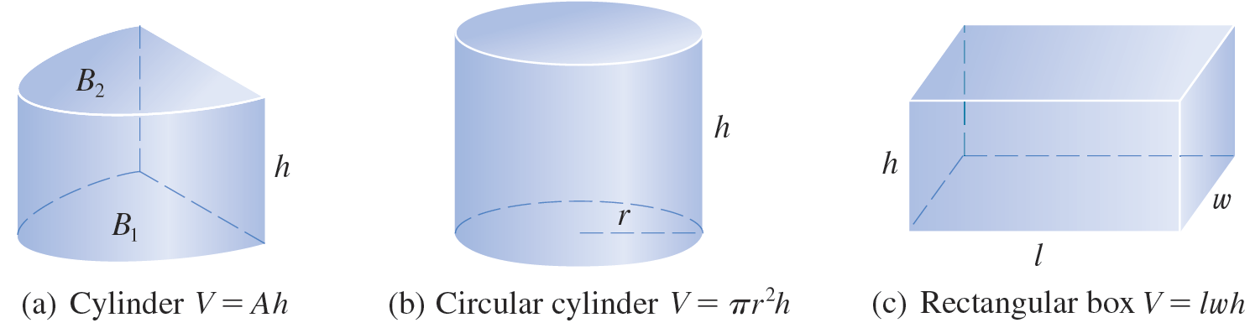
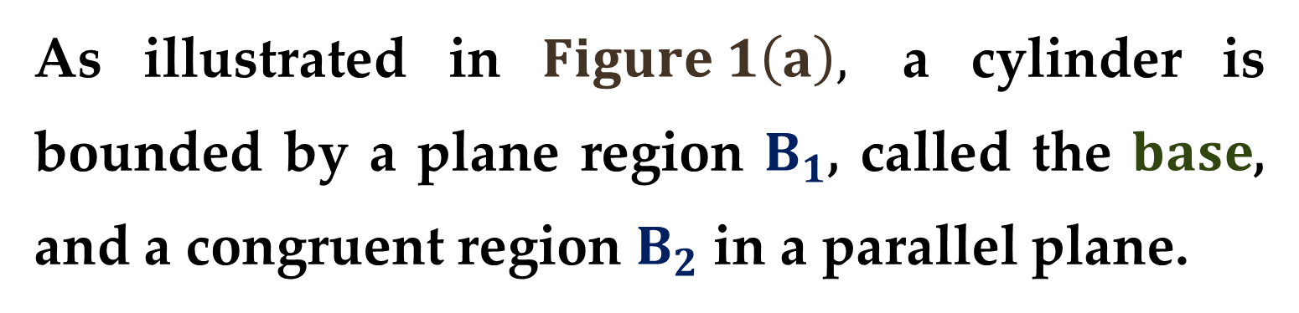
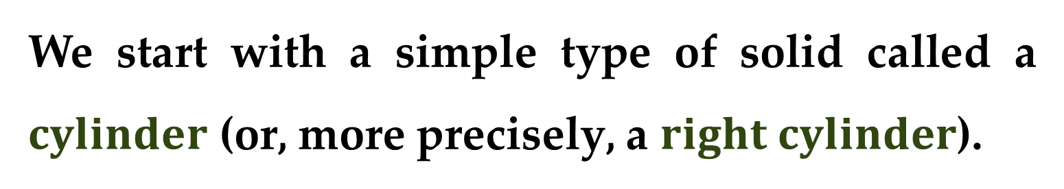
We start with a simple type of solid called a $cylinder$ (or, more precisely, a $right cylinder$).
As illustrated in $Figure 1\left(a\right),$ a cylinder is bounded by a plane region $B_{1}$, called the $base$, and a congruent region $B_{2}$ in a parallel plane.

Slide 5
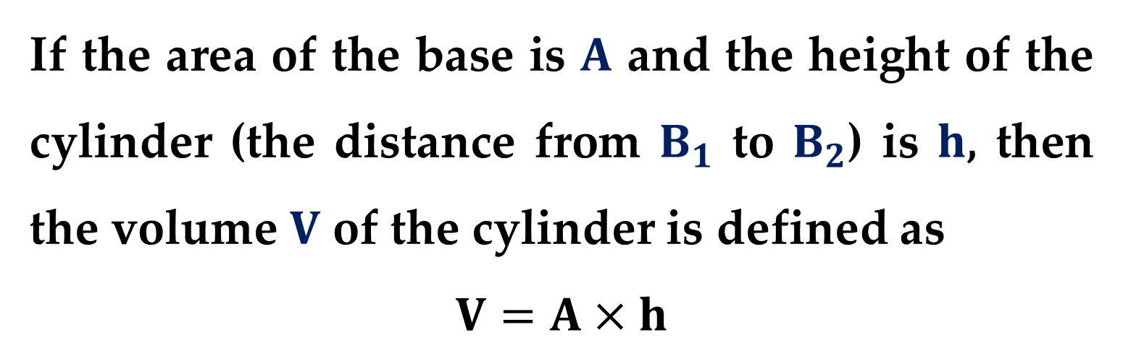
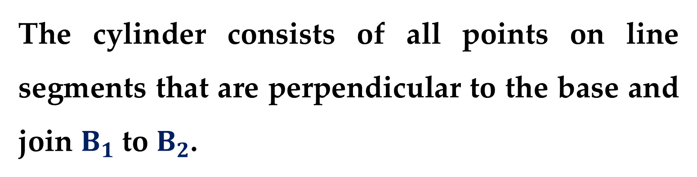
The cylinder consists of all points on line segments that are perpendicular to the base and join $B_{1}$ to $B_{2}$.
If the area of the base is $A$ and the height of the cylinder (the distance from $B_{1}$ to $B_{2}$) is $h$, then the volume $V$ of the cylinder is defined as
$$V=A×h$$

Slide 6
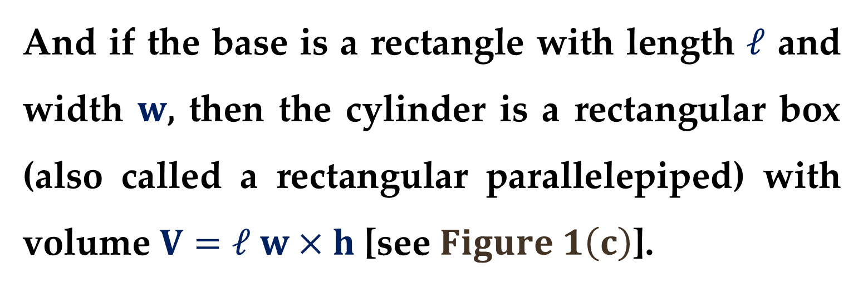
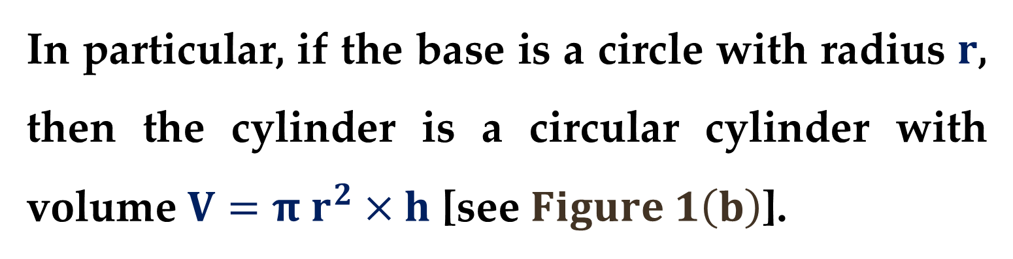
In particular, if the base is a circle with radius $r$, then the cylinder is a circular cylinder with volume $V=π r^{2}×h$ [see $Figure 1\left(b\right)$].
And if the base is a rectangle with length $ℓ$ and width $w$, then the cylinder is a rectangular box (also called a rectangular parallelepiped) with volume $V=ℓ w×h$ [see $Figure 1\left(c\right)$].

Slide 7
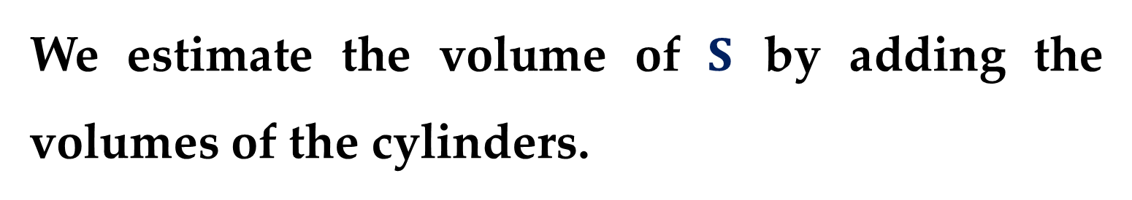
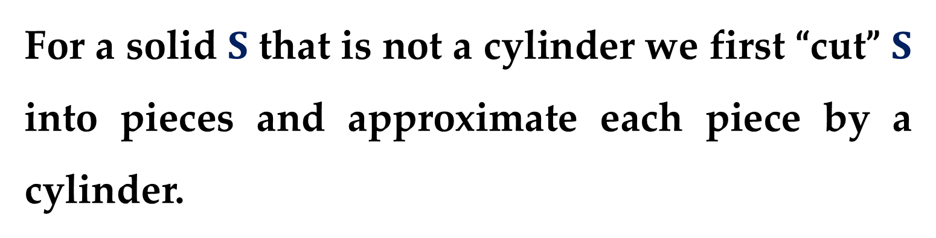
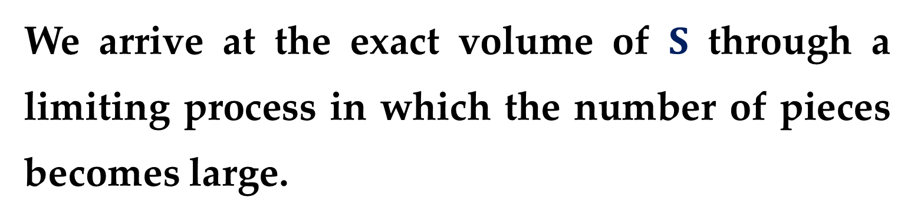
For a solid $S$ that is not a cylinder we first “cut” $S$ into pieces and approximate each piece by a cylinder.
We estimate the volume of $S$ by adding the volumes of the cylinders.
We arrive at the exact volume of $S$ through a limiting process in which the number of pieces becomes large.

Slide 8
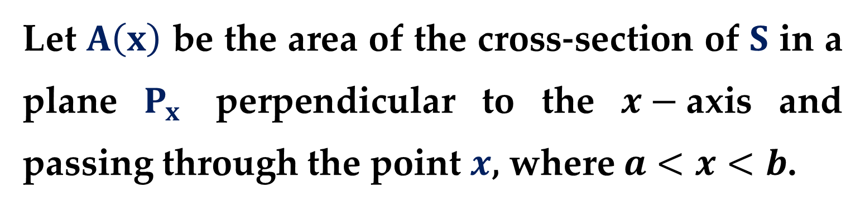
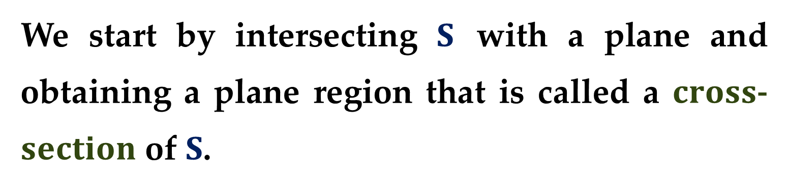
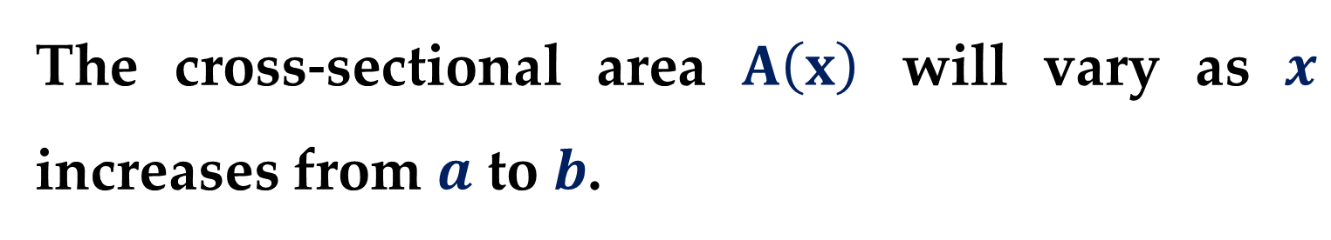
We start by intersecting $S$ with a plane and obtaining a plane region that is called a $cross$- $section$ of $S$.
Let $A\left(x\right)$ be the area of the cross-section of $S$ in a plane $P_{x}$ perpendicular to the $x−$axis and passing through the point $x$, where $a<x<b$.
The cross-sectional area $A\left(x\right)$ will vary as $x$ increases from $a$ to $b$.

Slide 9
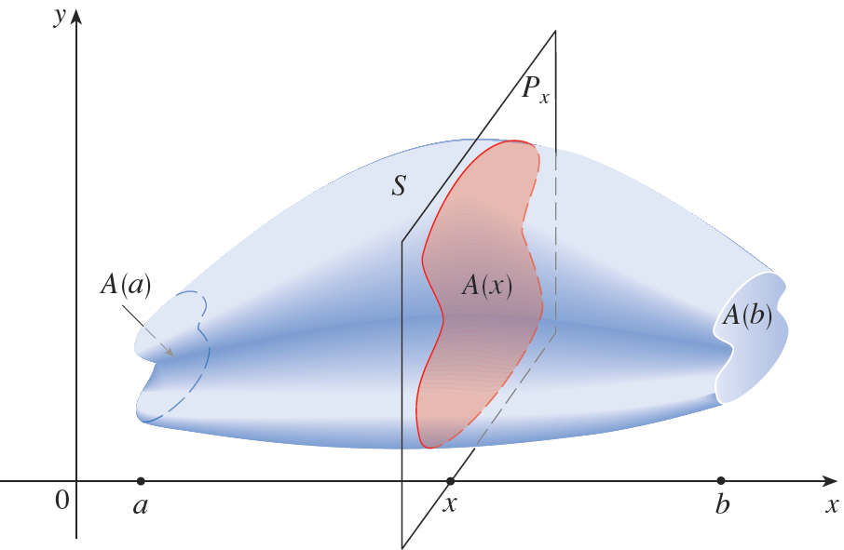
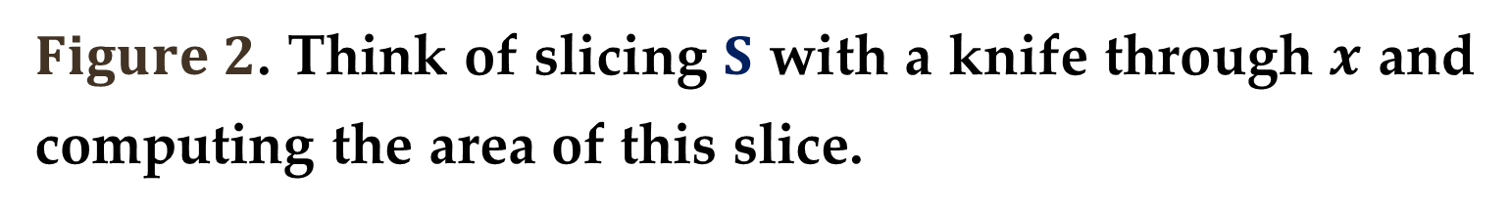
$Figure 2$. Think of slicing $S$ with a knife through $x$ and computing the area of this slice.

Slide 10
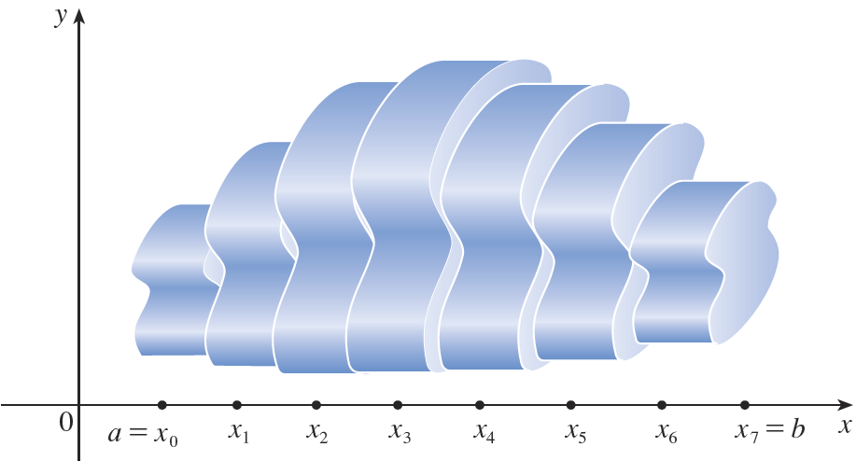
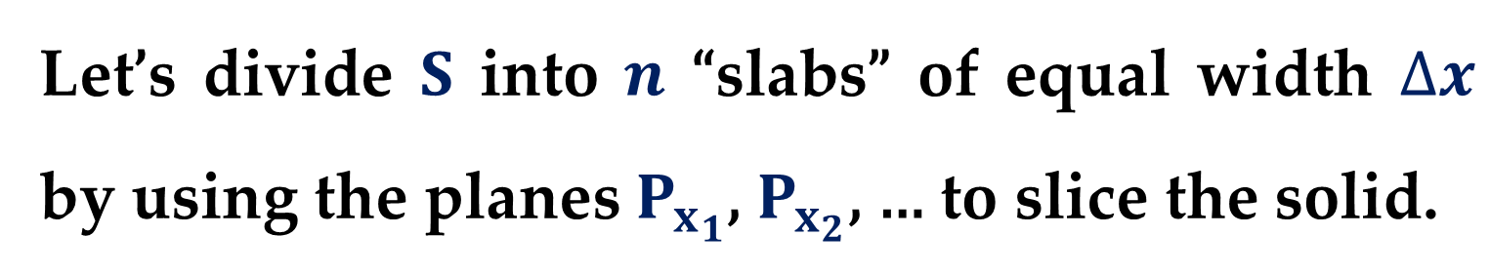
Let’s divide $S$ into $n$ “slabs” of equal width $∆x$ by using the planes $P_{x_{1}}$, $P_{x_{2}}$, … to slice the solid.

Slide 11
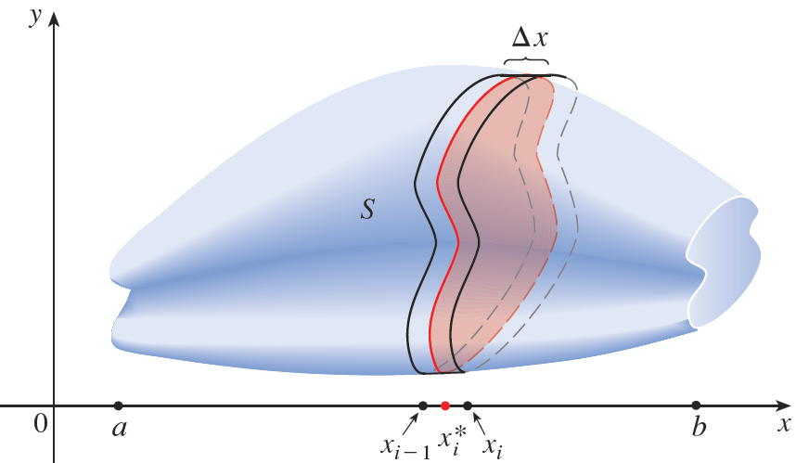
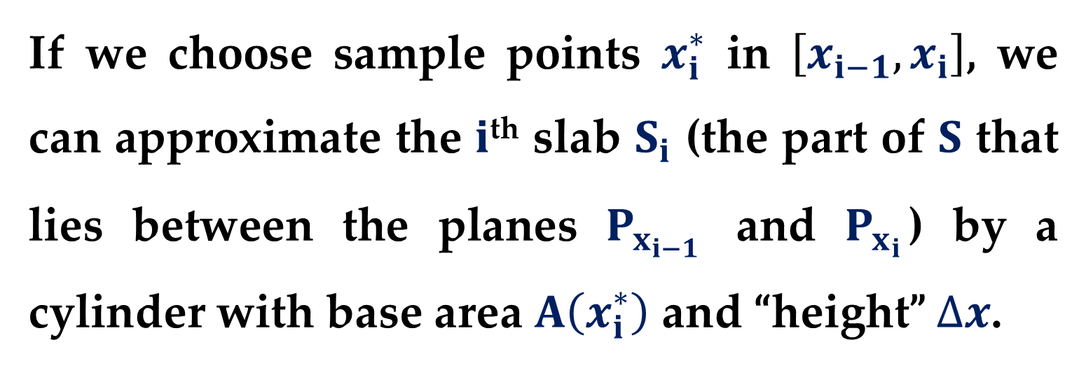
If we choose sample points $x_{i}^{∗}$ in $\left[x_{i−1},x_{i}\right]$, we can approximate the $i$^{th} slab $S_{i}$ (the part of $S$ that lies between the planes $P_{x_{i−1}}$ and $P_{x_{i}}$) by a cylinder with base area $A\left(x_{i}^{∗}\right)$ and “height” $∆x$.

Slide 12
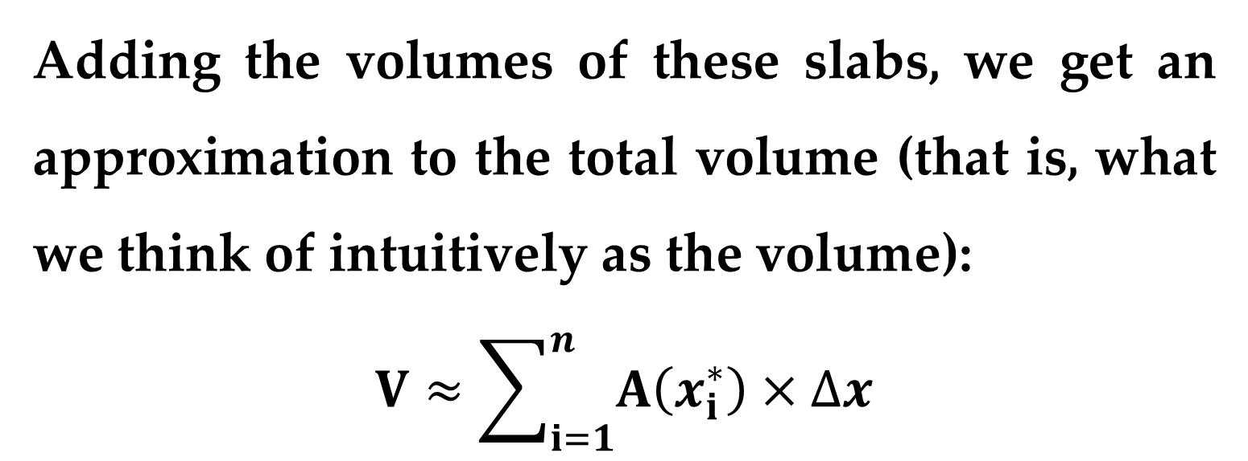
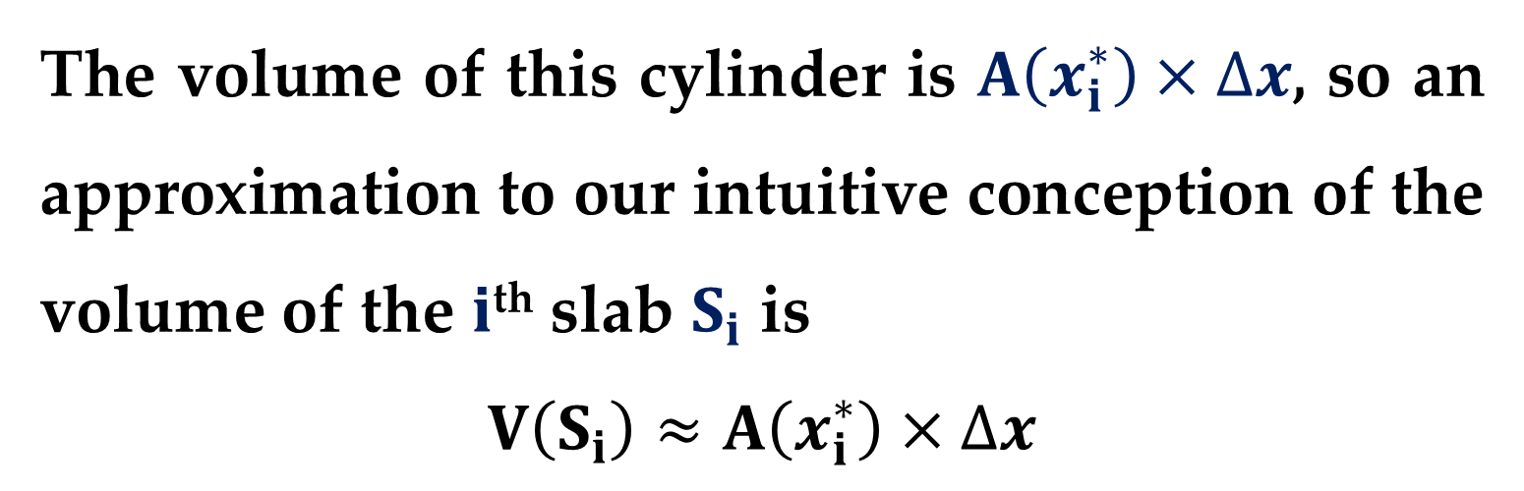
The volume of this cylinder is $A\left(x_{i}^{∗}\right)×∆x$, so an approximation to our intuitive conception of the volume of the $i$^{th} slab $S_{i}$ is
$$V\left(S_{i}\right)≈A\left(x_{i}^{∗}\right)×∆x$$
Adding the volumes of these slabs, we get an approximation to the total volume (that is, what we think of intuitively as the volume):
$$V≈\sum_{i=1}^{n}{A\left(x_{i}^{∗}\right)×∆x}$$

Slide 13
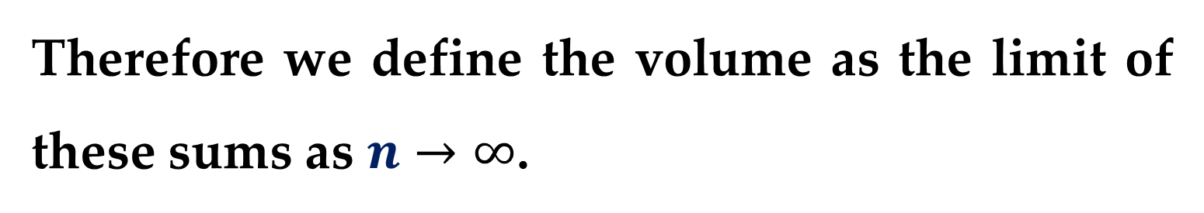
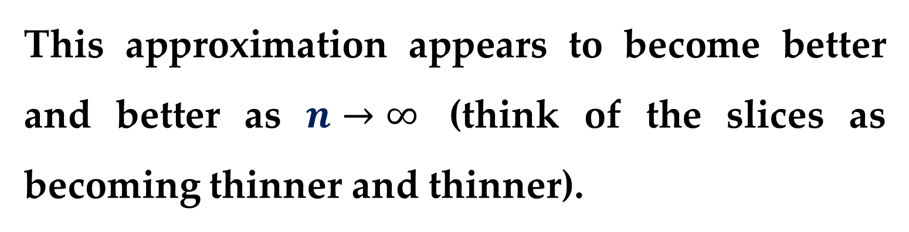
This approximation appears to become better and better as $n→∞$ (think of the slices as becoming thinner and thinner).
Therefore we define the volume as the limit of these sums as $n→∞$.
But we recognize the limit of Riemann sums as a definite integral and so we have the following definition.

Slide 14
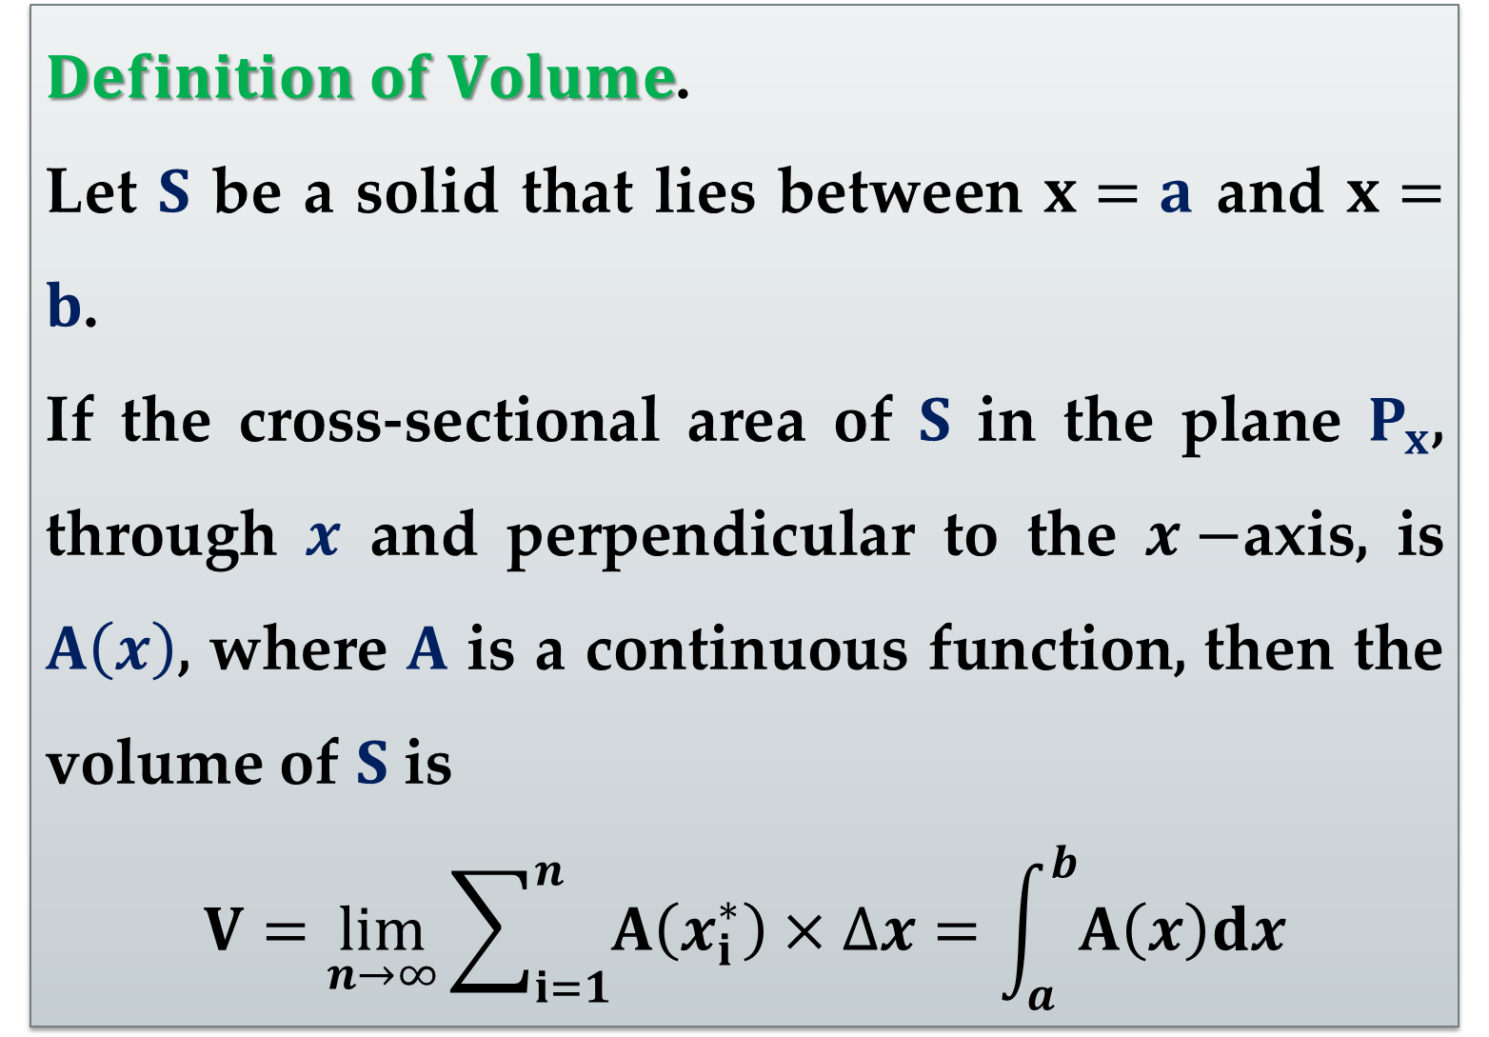
$Definition of Volume$.
Let $S$ be a solid that lies between $x=a$ and $x=b$.
If the cross-sectional area of $S$ in the plane $P_{x}$, through $x$ and perpendicular to the $x−$axis, is $A\left(x\right)$, where $A$ is a continuous function, then the volume of $S$ is
$$V=\lim_{n→∞}{\sum_{i=1}^{n}{A\left(x_{i}^{∗}\right)×∆x}}=\int_{a}^{b}{A\left(x\right)dx}$$

Slide 15
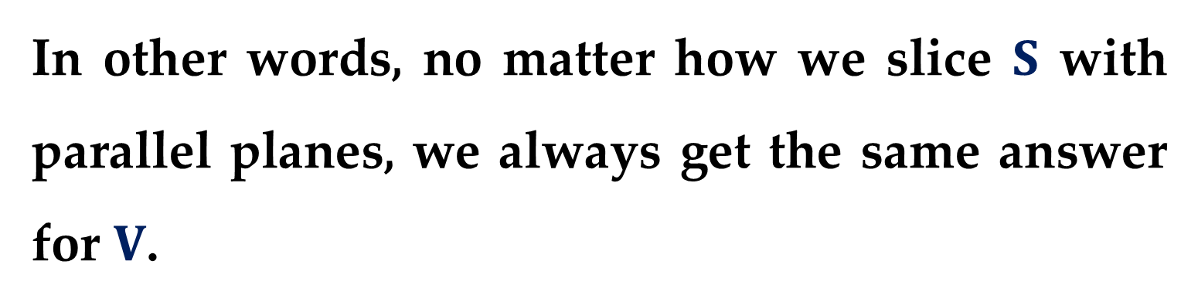
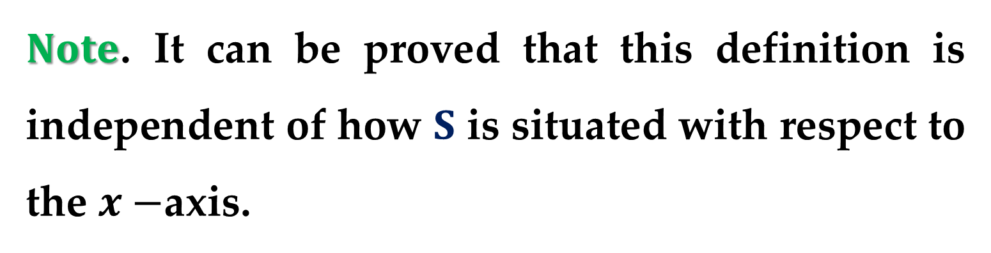
$Note$. It can be proved that this definition is independent of how $S$ is situated with respect to the $x−$axis.
In other words, no matter how we slice $S$ with parallel planes, we always get the same answer for $V$.

Slide 16
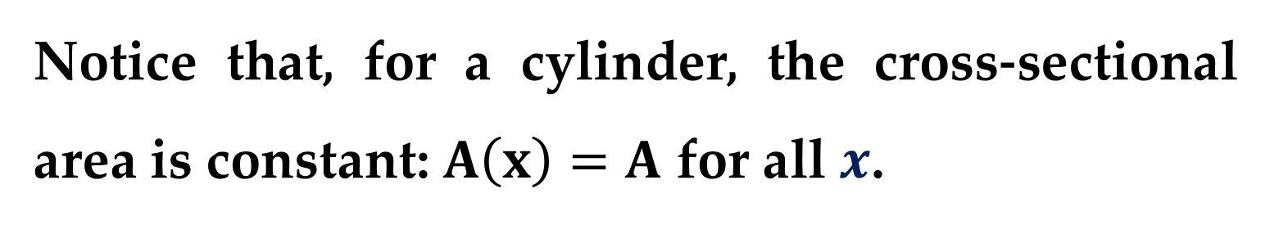
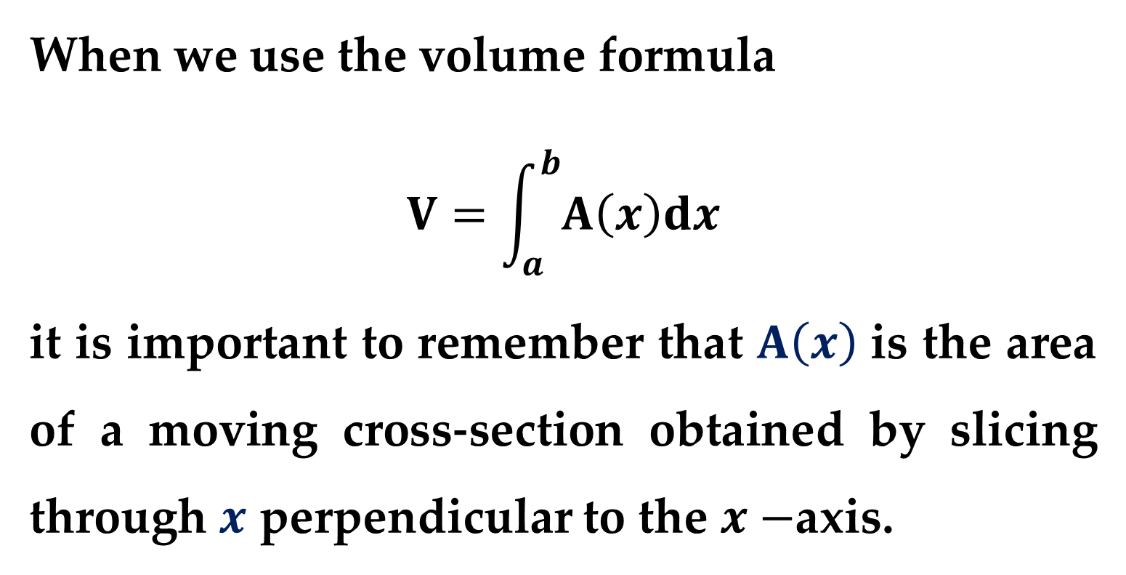
When we use the volume formula
$$V=\int_{a}^{b}{A\left(x\right)dx}$$
it is important to remember that $A\left(x\right)$ is the area of a moving cross-section obtained by slicing through $x$ perpendicular to the $x−$axis.
Notice that, for a cylinder, the cross-sectional area is constant: $A\left(x\right)=A$ for all $x$.

Slide 17
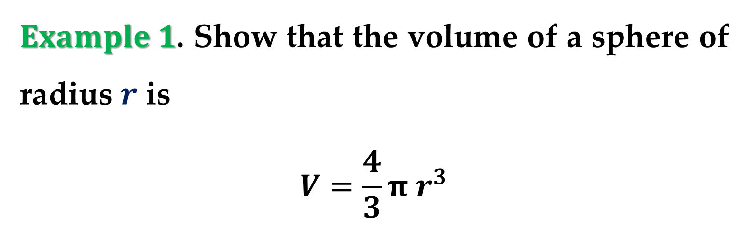
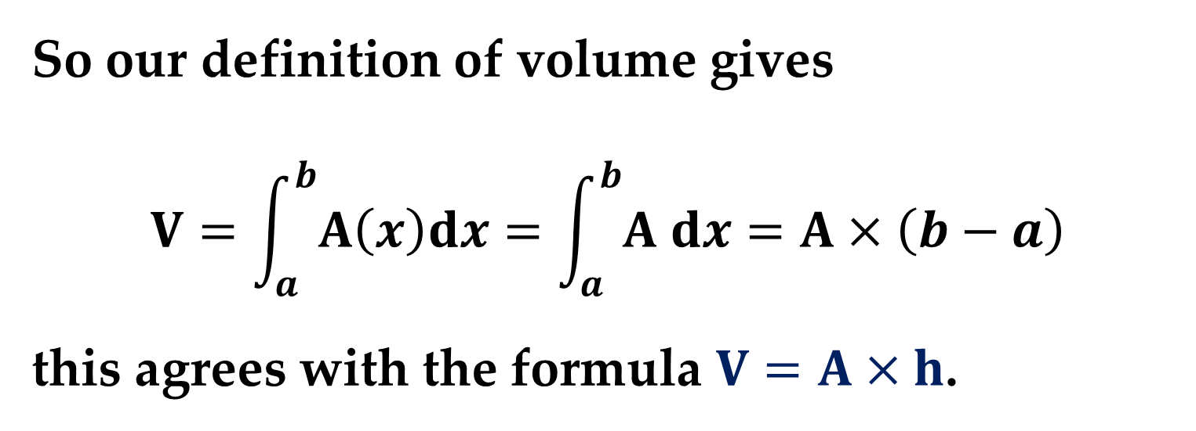
So our definition of volume gives
$$V=\int_{a}^{b}{A\left(x\right)dx}=\int_{a}^{b}{A dx}=A×\left(b−a\right)$$
this agrees with the formula $V=A×h$.
$Example 1$. Show that the volume of a sphere of radius $r$ is
$$V=\frac{4}{3}π r^{3}$$

Slide 18
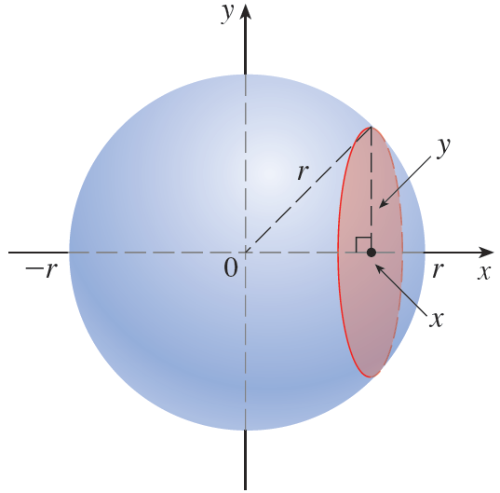
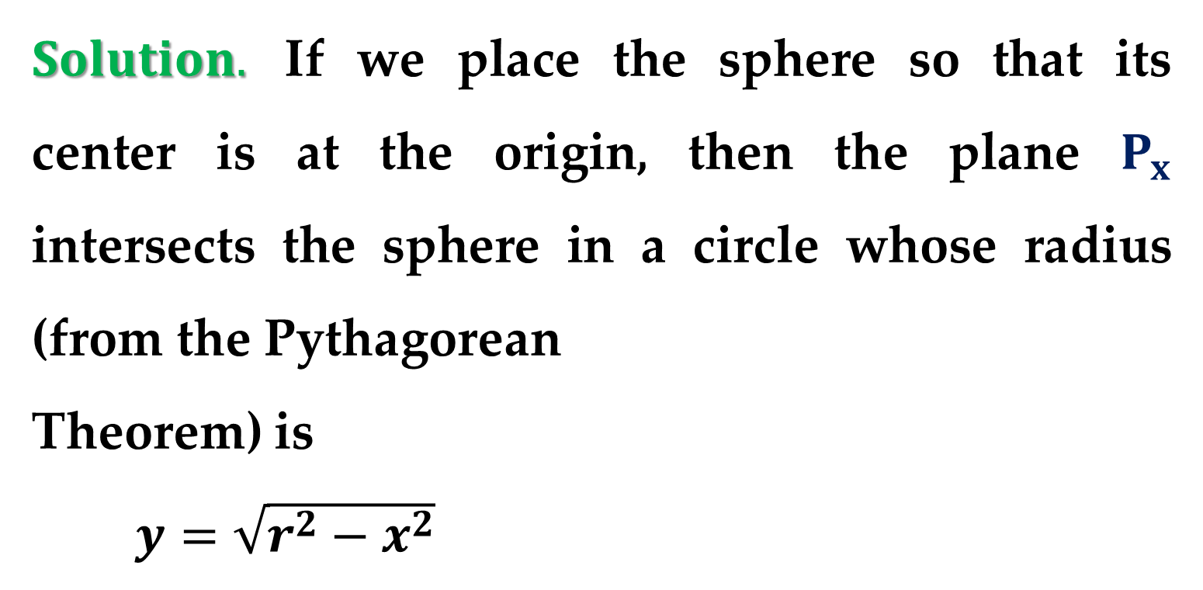
$Solution.$ If we place the sphere so that its center is at the origin, then the plane $P_{x}$ intersects the sphere in a circle whose radius (from the Pythagorean
Theorem) is
$y=\sqrt{r^{2}−x^{2}}$

Slide 19
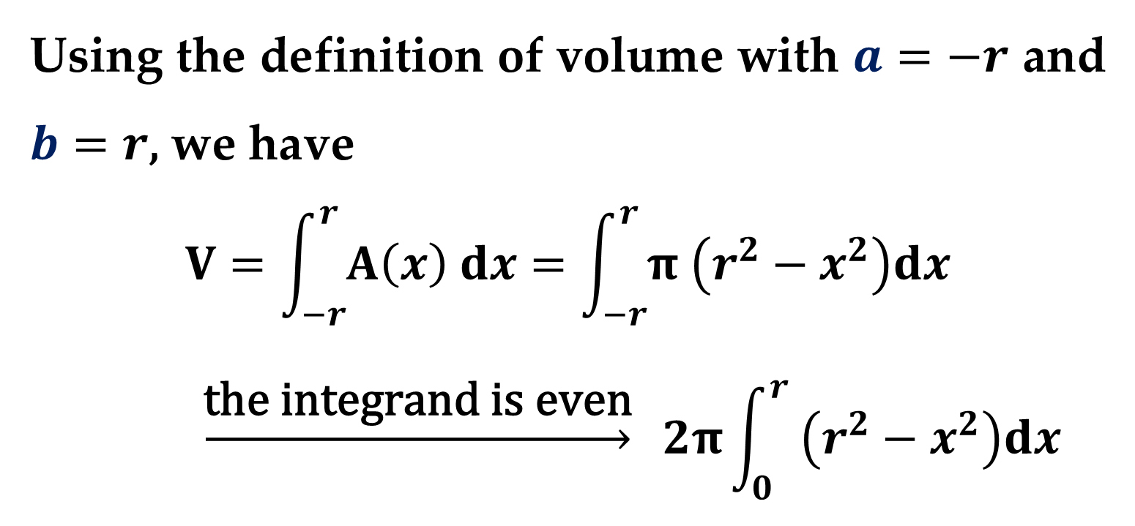
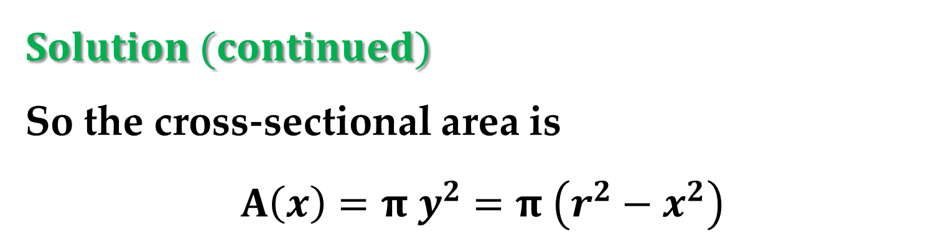
$$Solution (continued)$$
So the cross-sectional area is
$$A\left(x\right)=π y^{2}=π \left(r^{2}−x^{2}\right)$$
Using the definition of volume with $a=−r$ and $b=r$, we have
$$V=\int_{−r}^{r}{A\left(x\right) dx}=\int_{−r}^{r}{π \left(r^{2}−x^{2}\right)dx}$$
$$\underset{→}{\text{the} \text{integrand} \text{is} \text{even}} 2π\int_{0}^{r}{ \left(r^{2}−x^{2}\right)dx}$$

Slide 20
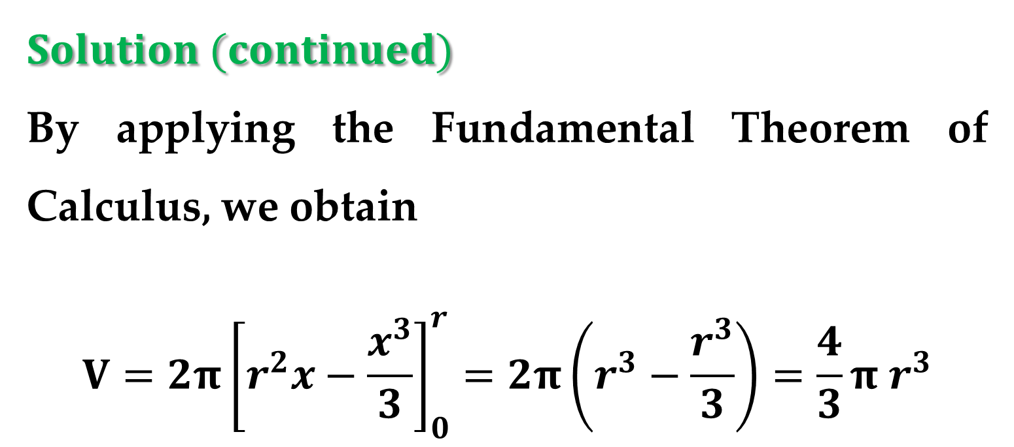
$$Solution (continued)$$
By applying the Fundamental Theorem of Calculus, we obtain
$$V=2π{\left[r^{2}x−\frac{x^{3}}{3}\right]}_{0}^{r}=2π\left(r^{3}−\frac{r^{3}}{3}\right)=\frac{4}{3}π r^{3}$$

Slide 21
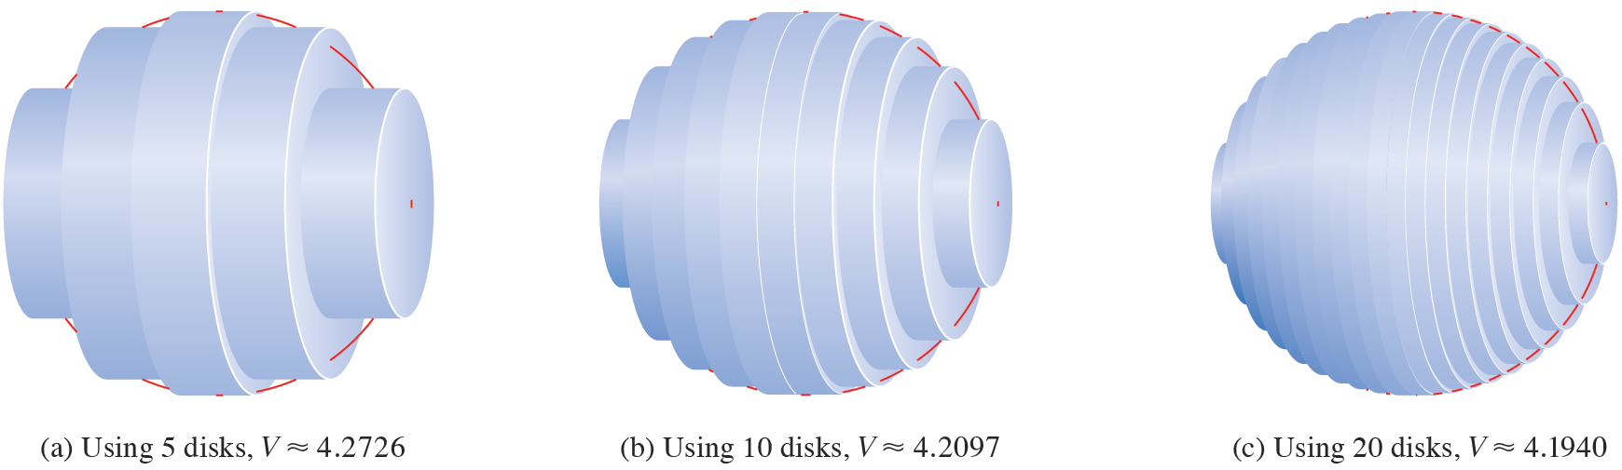
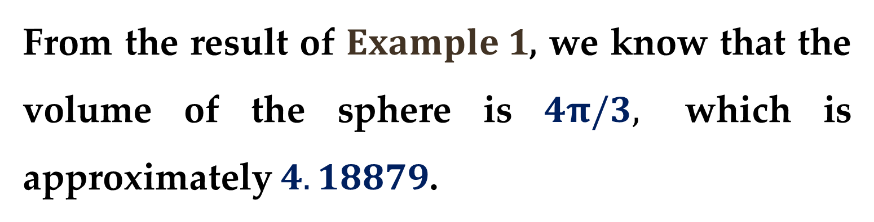
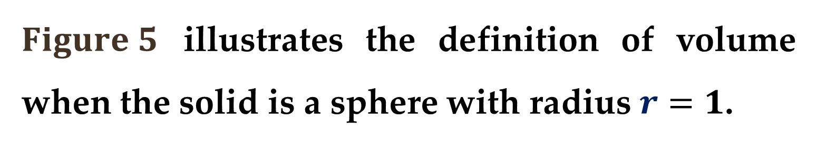
$Figure 5$ illustrates the definition of volume when the solid is a sphere with radius $r=1$.
From the result of $Example 1$, we know that the volume of the sphere is $4π/3,$ which is approximately $4.18879$.

Slide 22
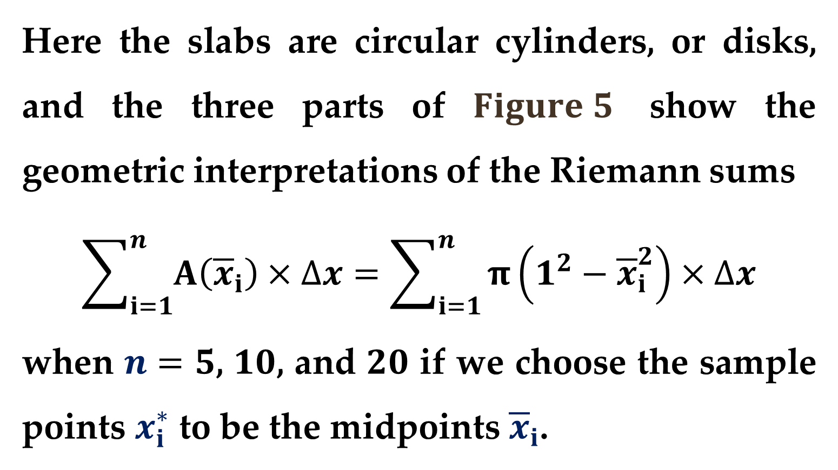
Here the slabs are circular cylinders, or disks, and the three parts of $Figure 5$ show the geometric interpretations of the Riemann sums
$$\sum_{i=1}^{n}{A\left({\overline{x}}_{i}\right)×∆x}=\sum_{i=1}^{n}{π\left(1^{2}−{\overline{x}}_{i}^{2}\right)×∆x}$$
when $n=5$, $10$, and $20$ if we choose the sample points $x_{i}^{∗}$ to be the midpoints ${\overline{x}}_{i}$.

Slide 23
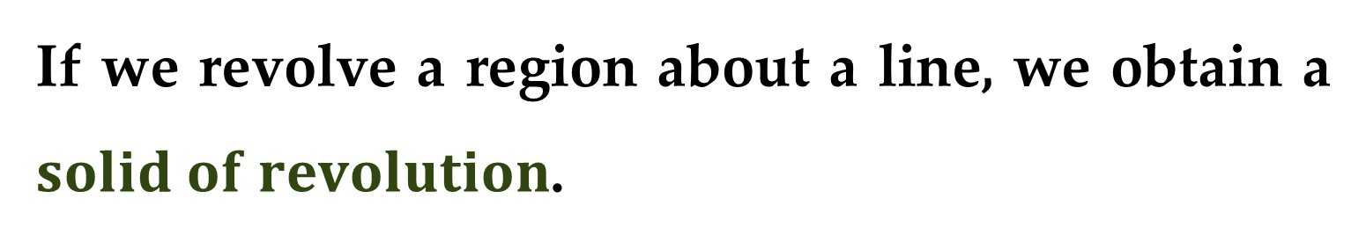
Notice that as we increase the number of approximating cylinders, the corresponding Riemann sums become closer to the true volume.
Next we consider a particular type of three-dimensional solid — one whose cross sections are similar.
If we revolve a region about a line, we obtain a $solid of revolution$.

Slide 24
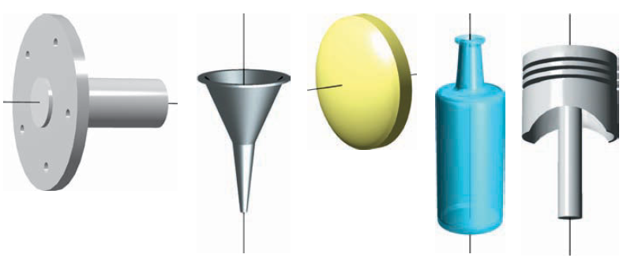
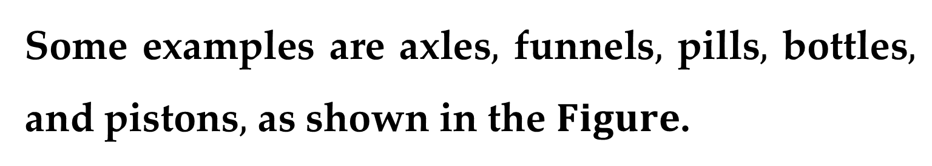
Solids of revolution are used commonly in engineering and manufacturing.
Some examples are axles$,$ funnels$,$ pills$,$ bottles$,$ and pistons$,$ as shown in the $Figure$.

Slide 25
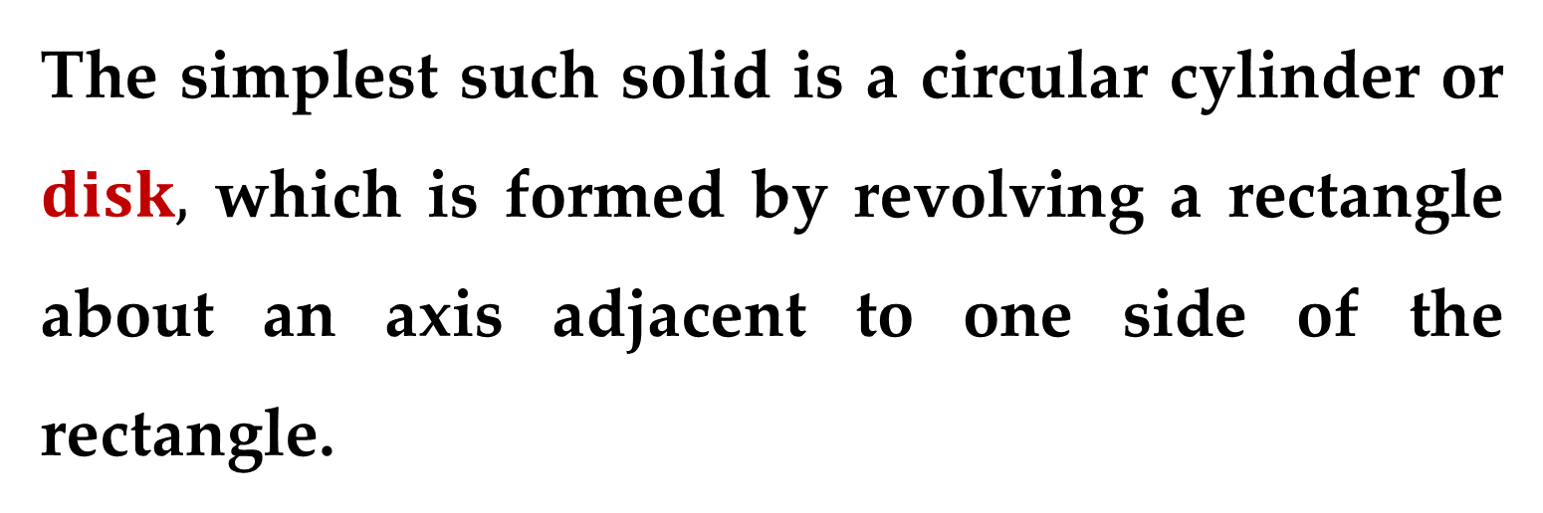
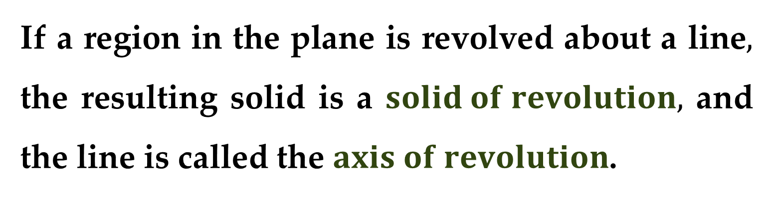
If a region in the plane is revolved about a line$,$ the resulting solid is a $solid of revolution,$ and the line is called the $axis of revolution$.
The simplest such solid is a circular cylinder or $disk,$ which is formed by revolving a rectangle about an axis adjacent to one side of the rectangle.

Slide 26
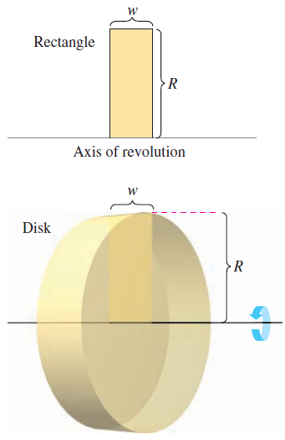
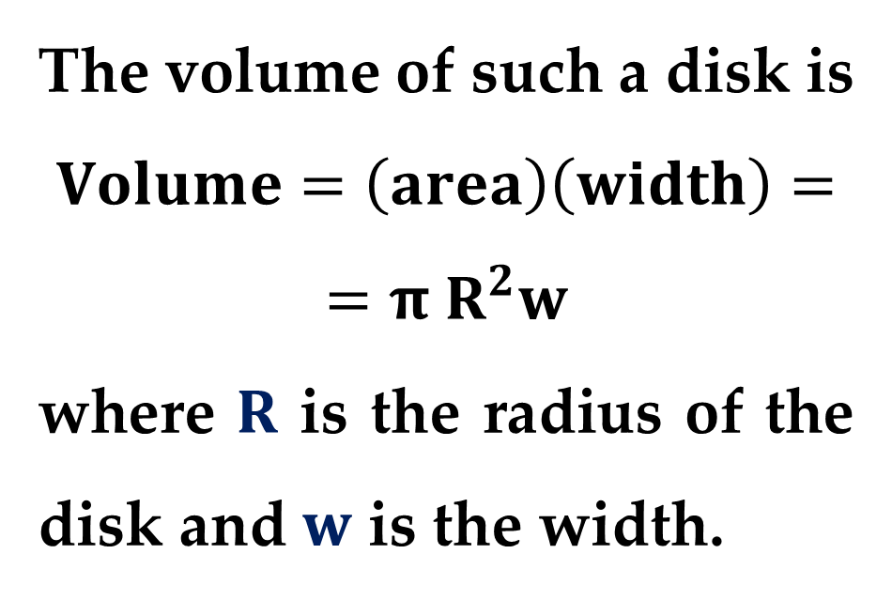
This process is shown in the Figure.
The volume of such a disk is
$$Volume=\left(area\right)\left(width\right)=$$
$$=π R^{2}w$$
where $R$ is the radius of the disk and $w$ is the width.

Slide 27
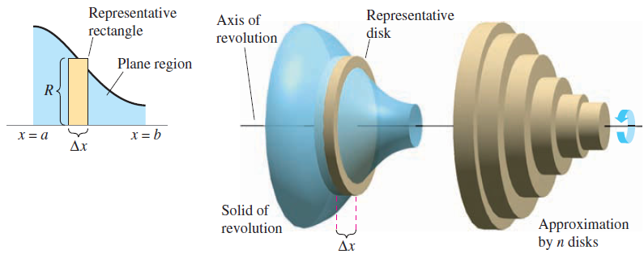
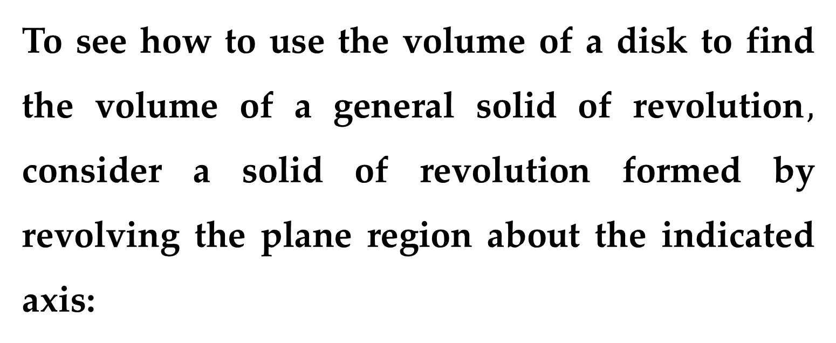
To see how to use the volume of a disk to find the volume of a general solid of revolution$,$ consider a solid of revolution formed by revolving the plane region about the indicated axis:

Slide 28
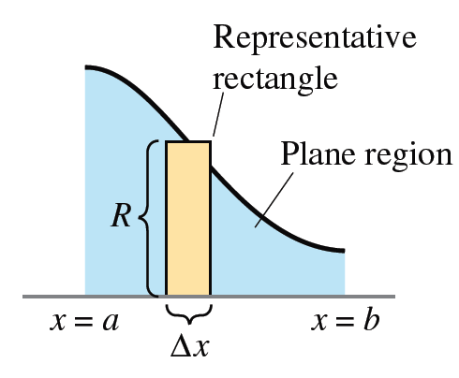

To determine the volume of this solid, consider a representative rectangle in the plane region.
When this rectangle is revolved about the axis of revolution$,$it generates a representative disk whose volume is
$$∆V=π R^{2}∆x$$

Slide 29

Approximating the volume of the solid by $n$ such disks of width $∆x$ and radius $R\left(x_{i}\right)$ produces
$$Volume of solid≈\sum_{i=1}^{n}{π{\left[R\left(x_{i}\right)\right]}^{2}∆x}=$$
$$=π\sum_{i=1}^{n}{{\left[R\left(x_{i}\right)\right]}^{2}∆x}$$

Slide 30


This approximation appears to become better and better as $\left\|∆\right\|→0$ ($n→∞$).
So$,$ you can define the volume of the solid as
$$Volume of solid=\lim_{n→∞}{π\sum_{i=1}^{n}{{\left[R\left(x_{i}\right)\right]}^{2}∆x}}$$
$$=π\lim_{n→∞}{\sum_{i=1}^{n}{{\left[R\left(x_{i}\right)\right]}^{2}∆x}}=π\int_{a}^{b}{{\left[R\left(x\right)\right]}^{2} dx}$$

Slide 31



Schematically$,$ the disk method looks like this:
$$Note$$
A similar formula can be derived if the axis of revolution is vertical.

Slide 32


$$The Disk Method$$
To find the volume of a solid of revolution with the disk method$,$ use one of the following:
$$V_{x}=π\int_{a}^{b}{{\left[R\left(x\right)\right]}^{2} dx} V_{y}=π\int_{c}^{d}{{\left[R\left(y\right)\right]}^{2} dy}$$
$$Horizontal Axis of Revolution Vertical Axis of Revolution$$

Slide 33


$$Note$$
You can determine the variable of integration by placing a representative rectangle in the plane region $“$perpendicular$”$ to the axis of revolution.
If the width of the rectangle is $∆x,$ integrate with respect to $x;$
If the width of the rectangle is $∆y,$ integrate with respect to $y.$

Slide 34


Consider the simplest application of the disk method that involves a plane region bounded by the graph of $f\left(x\right)$ and the $x−$axis.
If the axis of revolution is the $x−$axis$,$ the radius $R(x)$ is simply $f(x)$.

Slide 35


$$Example 2. Using the Disk Method$$
Find the volume of the solid formed by revolving the region bounded by the graph of
$$f\left(x\right)=\sqrt{\sin{x}}$$
and the $x−$axis $\left(0≤x≤π\right)$ about the $x−$axis.

Slide 36


$$Solution$$
From the representative rectangle on the left graph in the Figure above, you can see that the radius of this solid is
$$R\left(x\right)=f\left(x\right)=\sqrt{\sin{x}}$$
So, the volume of the solid of revolution is
$$V=π\int_{a}^{b}{{\left[R\left(x\right)\right]}^{2}dx}=π\int_{0}^{π}{{\left[\sqrt{\sin{x}}\right]}^{2}dx}$$

Slide 37


$$Solution (continued)$$
We then simplify the integrand as
$$V=π\int_{0}^{π}{\sin{x}dx}$$
And integrate
$$V=π{\left.\left[−\cos{x}\right]\right|}_{0}^{π}=π\left[1+1\right]=2π$$

Slide 38


$$Example 3. Revolving About a Line That Is Not$$
$$a Coordinate Axis$$
Find the volume of the solid formed by revolving the region bounded by $f\left(x\right)=2−x^{2}$ and $g\left(x\right)=1$ about the line $y=1$.

Slide 39



$$Solution$$
By equating $f\left(x\right)$ and $g\left(x\right)$, you can determine that the two graphs intersect when $x=±1$.
To find the radius, subtract $g\left(x\right)$ from $f\left(x\right)$:
$$R\left(x\right)=f\left(x\right)−g\left(x\right)$$
$$=\left(2−x^{2}\right)−1$$
$$=1−x^{2}$$
Finally, integrate between $−1$ and $1$ to find the volume.

Slide 40


$$Solution (continued)$$
Applying the disk method, we obtain
$$V=π\int_{a}^{b}{{\left[R\left(x\right)\right]}^{2}dx}=π\int_{−1}^{1}{{\left[1−x^{2}\right]}^{2}dx}$$
Then simplifying the integrand, we obtain
$$V=π\int_{−1}^{1}{\left(1−2x^{2}+x^{4}\right)dx}$$

Slide 41

$$Solution (continued)$$
And, finally, by integrating, we obtain
$$V=π{\left.\left[x−\frac{2}{3}x^{3}+\frac{1}{5}x^{5}\right]\right|}_{−1}^{1}$$
$$=\frac{16}{15}π$$

Slide 42


The disk method can be extended to cover solids of revolution with holes by replacing the representative disk with a representative $washer$.
The washer is formed by revolving a rectangle about an axis.

Slide 43


If $r$ and $R$ are the inner and outer radii of the washer and $w$ is the width of the washer$,$ the volume is given by
$$Volume of washer=π\left(R^{2}−r^{2}\right)w$$
To see how this concept can be used to find the volume of a solid of revolution$,$ consider a region bounded by an outer radius $R(x)$ and an inner radius $r(x)$.

Slide 44


If the region is revolved about its axis of revolution$,$ the volume of the resulting solid is given by
$$V=π\int_{a}^{b}{\left[R^{2}\left(x\right)−r^{2}\left(x\right)\right]dx} washer method$$

Slide 45
Note that the integral involving the inner radius represents the volume of the hole and is subtracted from the integral involving the outer radius.

Slide 46


$$Example 4. Using the Washer Method$$
Find the volume of the solid formed by revolving the region bounded by the graphs of $y=\sqrt{x}$ and $y=x^{2}$ about the $x−$axis.

Slide 47


$$Solution$$
In the Figure above, you can see that the outer and inner radii are as follows:
$R\left(x\right)=\sqrt{x}$ and $r\left(x\right)=x^{2}$
Applying the washer method (by integrating between $0$ and $1$) produces:
$$V=π\int_{a}^{b}{\left[R^{2}\left(x\right)−r^{2}\left(x\right)\right]dx}$$

Slide 48



$$Solution (continued)$$
$$V=π\int_{0}^{1}{\left[{\left(\sqrt{x}\right)}^{2}−{\left(x^{2}\right)}^{2}\right]dx}$$
We then simplify the integrand:
$$V=π\int_{0}^{1}{\left[x−x^{4}\right]dx}$$
And integrate:
$$V=π{\left.\left[\frac{1}{2}x^{2}−\frac{1}{5}x^{5}\right]\right|}_{0}^{1}=\frac{3}{10}π$$

Slide 49


In each example so far$,$ the axis of revolution has been horizontal and we have integrated with respect to $x$.
In the next example$,$ the axis of revolution is vertical and we integrate with respect to $y$ – we will need two separate integrals to compute the volume.

Slide 50


$$Example 5. Integrating with Respect to y$$
Find the volume of the solid formed by revolving the region bounded by the graphs of
$$y=x^{2}+1, y=0, x=0, x=1$$
about the $y−$axis.

Slide 51


$$Solution$$
For the region shown in the Figure above, the outer radius is simply $R=1$.
There is, however, no convenient formula that represents the inner radius.
When $0≤y≤1,$ $r=0;$ but when $1≤y≤2,$ $r$ is determined by the equation $y=x^{2}+1,$ which implies that $r=\sqrt{y−1}$.

Slide 52


$$Solution (continued)$$
So
$$r\left(y\right)=\left\{\begin{matrix}0, 0≤y≤1 \\ \sqrt{y−1}, 1≤y≤2\end{matrix}\right.$$
Using this definition of the inner radius, you can use two integrals to find the volume:
$$V=π\int_{0}^{1}{\left(1^{2}−0^{2}\right)dy}+π\int_{1}^{2}{\left(1^{2}−{\left(\sqrt{y−1}\right)}^{2}\right)dy}$$

Slide 53


$$Solution (continued)$$
Simplifying the integrand, we obtain:
$$V=π\int_{0}^{1}{dy}+π\int_{1}^{2}{\left(2−y\right)dy}$$
Integrating both integrals, we obtain:
$$V=π{\left.\left[y\right]\right|}_{0}^{1}+π{\left.\left[2y−\frac{1}{2}y^{2}\right]\right|}_{1}^{2}=\frac{3}{2}π$$

Slide 54

$$Solution$$
Note that the first integral
$$π\int_{0}^{1}{1 dy}$$
represents the volume of a right circular cylinder of radius $1$ and height $1$.
This portion of the volume could have been determined without using calculus.

Slide 55



$$Example 6. Manufacturing$$
A manufacturer drills a hole through the center of a metal sphere of radius $5$ inches$,$ as shown in Figure $(a)$.
The hole has a radius of $3$ inches.
What is the volume of the resulting metal ring?

Slide 56


$$Solution$$
You can imagine the ring to be generated by a segment of the circle whose equation is
$$x^{2}+y^{2}=25$$
as shown in
$Figure \left(b\right)$.

Slide 57


$$Solution (continued)$$
Because the radius of the hole is $3$ inches, you can let $y=3$ and solve the equation $x^{2}+y^{2}=25$ to determine that the limits of integration are $x=±4$.
So, the inner and outer radii are $r\left(x\right)=3$ and $R\left(x\right)=\sqrt{25−x^{2}}$ and the volume is given by
$$V=π\int_{a}^{b}{\left[R^{2}\left(x\right)−r^{2}\left(x\right)\right]}dx$$

Slide 58


$$Solution (continued)$$
Which yields
$$V=π\int_{−4}^{4}{\left[{\left(\sqrt{25−x^{2}}\right)}^{2}−3^{2}\right]dx}$$
Simplifying the integrand yields
$$V=π\int_{−4}^{4}{\left(16−x^{2}\right)dx}$$

Slide 59

$$Solution (continued)$$
Integrating the definite integral yields
$$V=π{\left.\left[16x−\frac{1}{3}x^{3}\right]\right|}_{−4}^{4}=\frac{256}{3}π cubic inches$$

Slide 60



$Solids with Known Cross Sections$
With the disk method$,$ you can find the volume of a solid having a circular cross section whose area is $A=πR^{2}.$
This method can be generalized to solids of any shape$,$ as long as you know a formula for the area of an arbitrary cross section.
Some common cross sections are squares, rectangles$,$ triangles$,$ semicircles$,$ and trapezoids.

Slide 61


For cross sections of area $A\left(x\right)$taken perpendicular to the $x−$axis
$$Volume=\int_{a}^{b}{A\left(x\right) dx}$$

Slide 62


For cross sections of area $A\left(y\right)$taken perpendicular to the $y−$axis
$$Volume=\int_{c}^{d}{A\left(y\right) dy}$$

Slide 63



$$Example 7. Triangular Cross Sections$$
Find the volume of the solid (see in the Figure).
The base of the solid is the region bounded by the lines
$$f\left(x\right)=1−\frac{x}{2}, g\left(x\right)=−1+\frac{x}{2}, x=0$$

Slide 64



$$Example 7 (continued)$$
The cross sections perpendicular to the $x−$axis are equilateral triangles.
Solution
The base and area of each triangular cross section are as follows:
$$Base=\left(1−\frac{x}{2}\right)−\left(−1+\frac{x}{2}\right)=2−x$$
$Area=\frac{\sqrt{3}}{4}{\left(Base\right)}^{2}$ – area of equilateral triangle

Slide 65


Solution (continued)
$A\left(x\right)=\frac{\sqrt{3}}{4}{\left(2−x\right)}^{2}$ – area of cross section
Because $x$ ranges from $0$ to $2,$ the volume of the solid is
$$V=\int_{0}^{2}{A\left(x\right) dx}=\int_{0}^{2}{\frac{\sqrt{3}}{4}{\left(2−x\right)}^{2} dx}$$

Slide 66


$$Example 8. An Application to Geometry$$
Prove that the volume of a pyramid with a square base is
$$V=\frac{1}{3}hB$$
where $h$ is the height of
the pyramid and $B$ is
the area of the base.

Slide 67



Solution
As shown in the Figure above$,$ we can intersect the pyramid with a plane parallel to the base at height $y$ to form a square cross section whose sides are of length $b′$.
Using similar triangles$,$
we can show that
$$\frac{b^{′}}{b}=\frac{h−y}{h}→b^{′}=\frac{b}{h}\left(h−y\right)$$

Slide 68


Solution (continued)
So
$$A\left(y\right)={\left(b^{′}\right)}^{2}=\frac{b^{2}}{h^{2}}{\left(h−y\right)}^{2}$$
Integrating between $0$ and $h$ produces
$$V=\int_{0}^{h}{A\left(y\right)dy}=\int_{0}^{h}{\frac{b^{2}}{h^{2}}{\left(h−y\right)}^{2}dy}$$
$$∗∗∗$$

Slide 69
Thank you for attention

